Slide 1


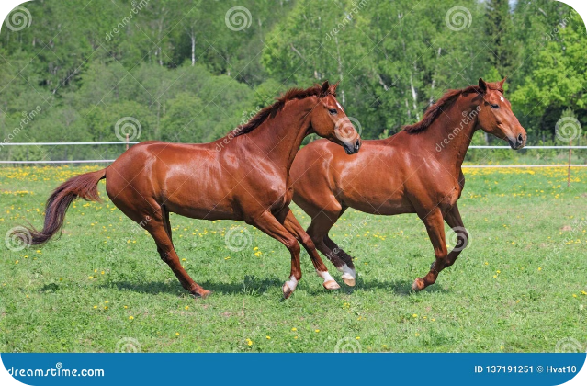


Horse Race Prediction Project
This presentation outlines a comprehensive approach to horse race prediction. We will explore data collection, preprocessing, analysis, and modeling techniques to build a robust predictive model.
by umamaheswari selvaraj

Slide 2


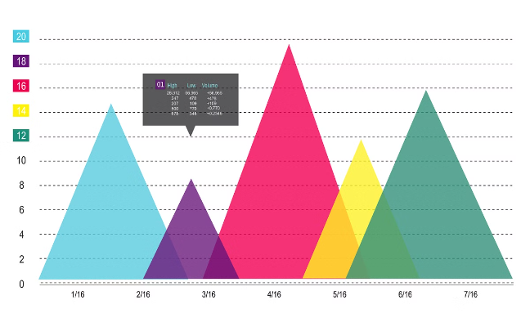
Data Collection and Cleaning
1
Data Sources
2
Data Validation
We gather data from various sources, including official race results, horse pedigrees, jockey statistics, and weather conditions.
We check for inconsistencies, missing values, and outliers. We also ensure data types and formats are correct.
3
Data Cleaning
4
Data Transformation
We handle missing values using appropriate methods and remove outliers to improve data quality.
We apply transformations to numerical variables, like scaling and normalization, for better model performance.

Slide 3
Exploratory Data Analysis (EDA)
Descriptive Statistics
Data Visualization
Feature Importance
We calculate summary statistics like mean, median, and standard deviation for each feature.
We use histograms, scatter plots, and box plots to explore relationships between variables and identify patterns.
We analyze the impact of each feature on the outcome of races, helping us understand key predictors.

Slide 4

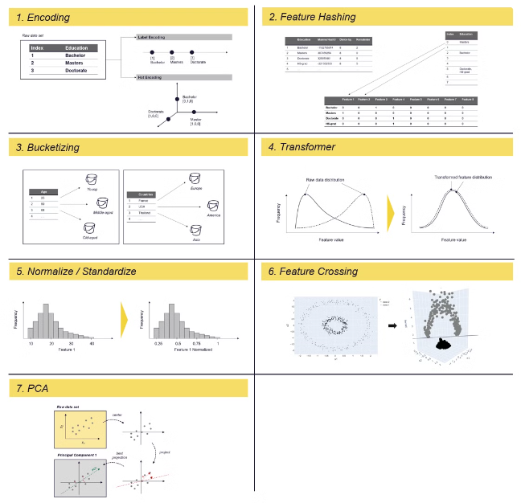
Feature Engineering and Selection
1
Feature Engineering
We create new features from existing ones, like combining jockey and trainer information.
2
Feature Selection
We employ techniques like Recursive Feature Elimination (RFE) to select the most relevant features.
3
Feature Scaling
We scale features to a common range to ensure they contribute equally to the model.

Slide 5

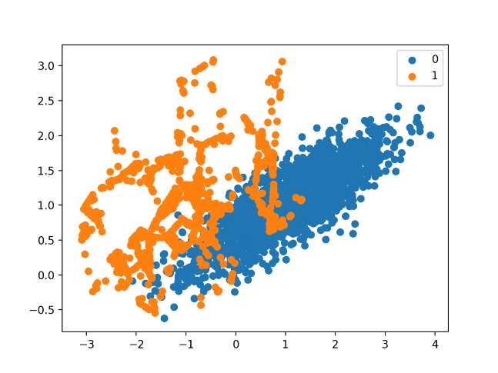



Handling Imbalanced Data with SMOTE
Data Imbalance
Horse race outcomes are inherently imbalanced, with a small percentage of horses winning.
SMOTE (Synthetic Minority Over-sampling Technique)
SMOTE addresses this imbalance by generating synthetic minority class data points.
Balanced Dataset
SMOTE creates a balanced dataset for training, leading to more accurate and reliable predictions.

Slide 6
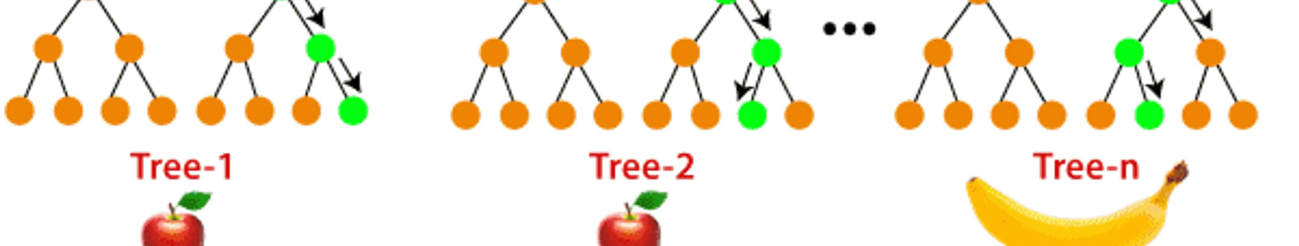
Modeling with Random Forest Algorithm
Algorithm
Random Forest
Type
Ensemble Learning
Benefits
High accuracy, robustness to outliers, feature importance
Process
Constructs multiple decision trees and combines their predictions.

Slide 7

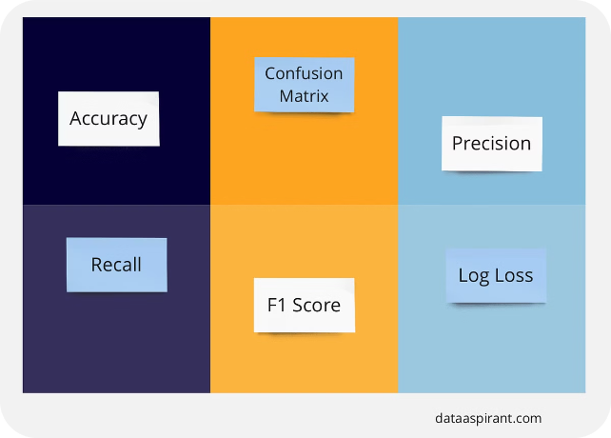
Model Evaluation and Performance Metrics
Accuracy
Precision
Measures the proportion of correctly predicted outcomes.
Represents the ratio of true positives to the sum of true positives and false positives.
Recall
F1-Score
Indicates the proportion of actual positive cases correctly identified.
A harmonic mean of precision and recall, providing a balanced measure of performance.

Slide 8


Conclusion and Next Steps
This project demonstrates the potential of data science for predicting horse race outcomes. Future work could explore advanced algorithms, incorporate real-time data, and develop a user-friendly interface for prediction.

